Slide 1
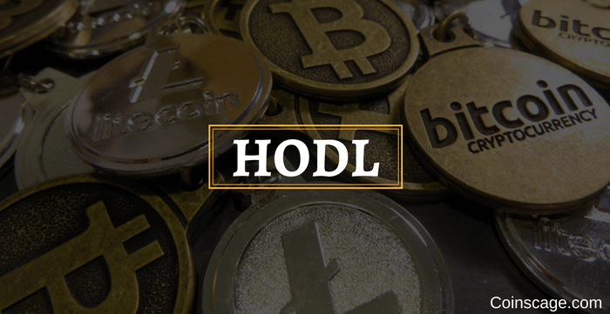
Feel free to fork and make good - but will appreciate revised versions shared again with ezhang@vertexventures.com.
Primer on Blockchain
& Token-economics
‘To hodl or not to hold…’
Making sense of a clashing parallel universe
Elvin Zhang

Slide 2
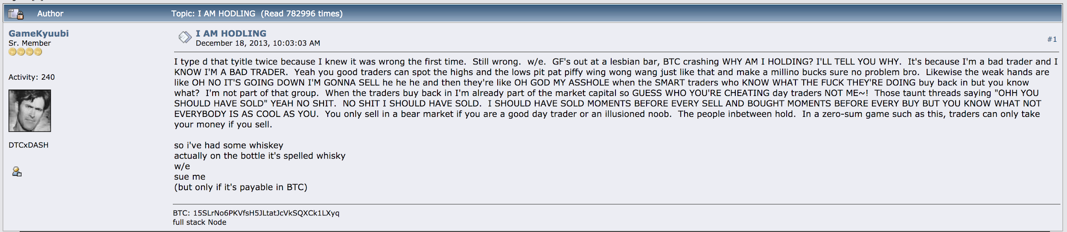
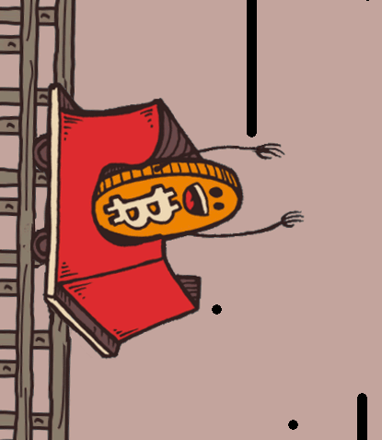
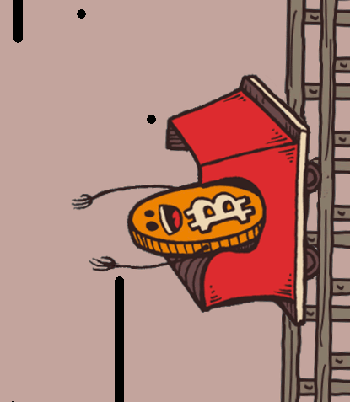
Rethinking value capture
Hodl/Moon/many more..
Bitcointalk/Reddit thread 2013
Why does it grow?
Pre-crypto = mostly transactional utility captured by centralized capitalist models
Crypto = transactional + sociological utility captured by new decentralized economic models (ie. radicalness/belongingness - rethinking value capture models)
Notes:
https://bitcointalk.org/index.php?topic=375643.0 <--Screenshot
Storyline of current
Group mentality > possibly first case of capturing communal value > communal distrust of present financial institutions
https://bitcointalk.org/index.php?topic=375643.0

Slide 3
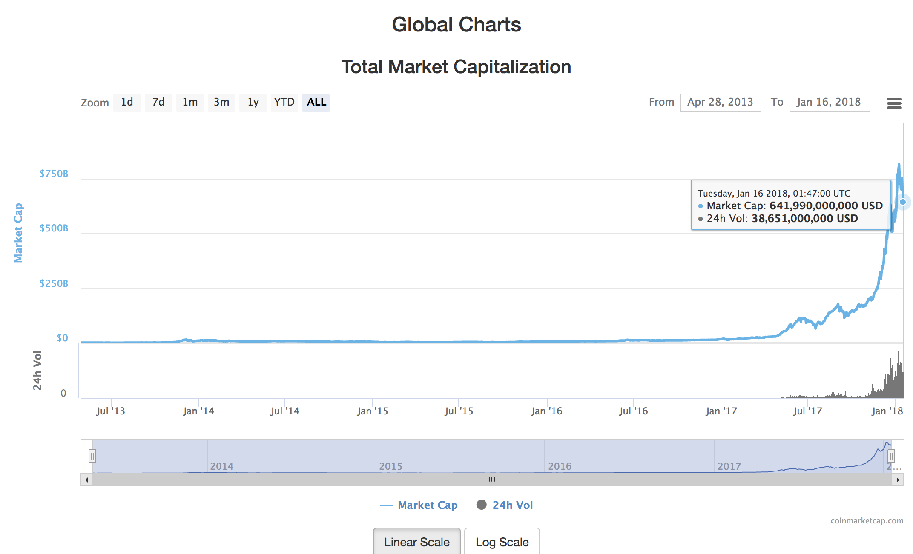
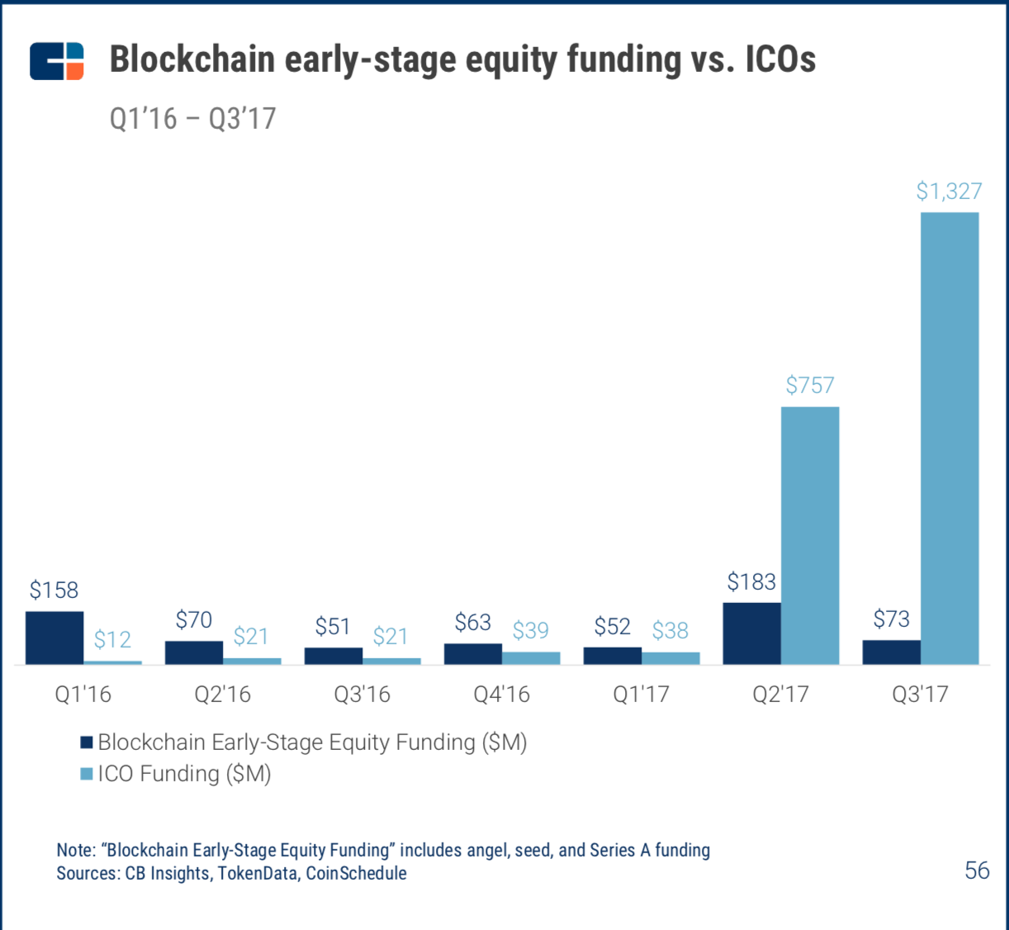
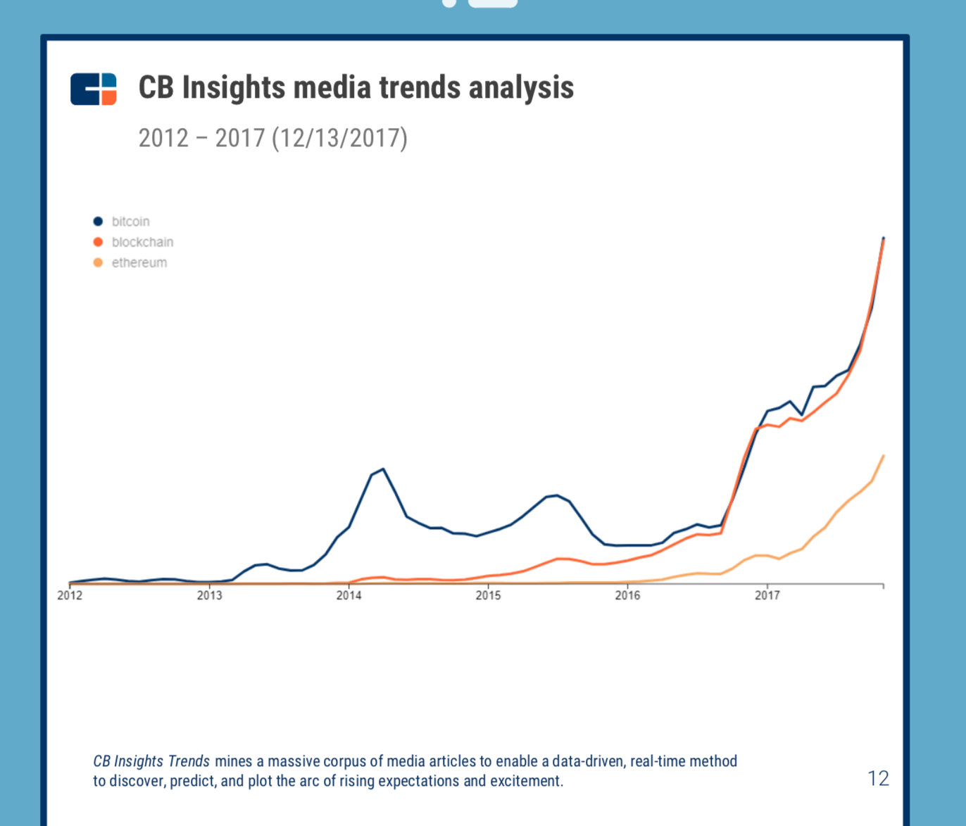
Why should a VC care?
Funding Risk
High market-cap, faster liquidity and even its volatility appeals to AIs and IIs
Lack of understanding of industry and a convincing position reflects badly to potential LPs.
Portfolio Risk
Competitive threat to existing portfolio
Lower exposure and mindshare for traditional startups (buzzword sells)
Increased firepower by crypto-funded startups
Deployment Risk
Alluring funding option for early stage startups
Capital is more readily available via other routes = better bargaining position for startups in general.

Slide 4
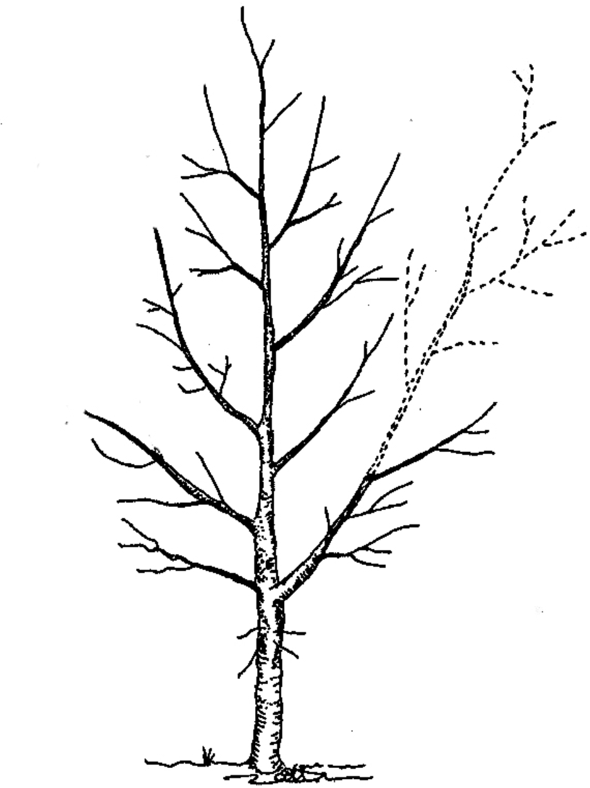
Notes on Presentation
“If trust is the underlying principle underpinning all human interaction and inventions, then a disruption on the trust - level, will disrupt everything we sapiens have previously conceived.”
‘Anonymous’
Trunk vs Branch
Crypto-universe = Massive (rethinking internet technology + fundamental economics + sociology)
Establishing the trunk – with option to deep dive into respective branches
Underlying trunk = Disrupting “trust” networks
Evolving space
Frontier space constantly being shaped and ever evolving
Focus of Preso

Slide 5
Structure of Presentation
4 Sections
Technology recap = How a Token has value and its relationship to the blockchain.
Basic stack of a blockchain
The Token Economy
3 Fundamental questions before throwing the word blockchain around
Types of Tokens
General ICO scene
Challenges faced by the token economy
Beyond ICOs
The “Sleeping Giant 2.0” - China’s role in the global token-economy [Confidential for now - sneakpeak - will share more]
Summary
Overall Tips
Possible Future Developments
Notes:
#challenges, scalability = PoS, DAG-based Hashgraph

Slide 6
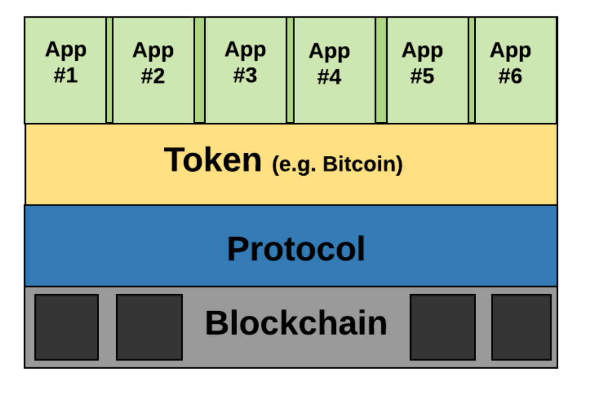
Tech Recap - Deriving value from a token
A basic public blockchain stack
Can literally be any service or product
that answers the question “what the underlying technology is good for in the real world?”
The digital asset (unit of account) of the Blockchain/DLT, follows Protocol and can be distributed throughout the network for value allocation
The rules of a blockchain network defining how nodes (participants) of the network can operate.
Replicated/duplicated database that keeps a permanent immutable record of transactions.
Notes:
Examples at every layer
>> Parallels at every layer (token vs equity/revenue?)

Slide 7

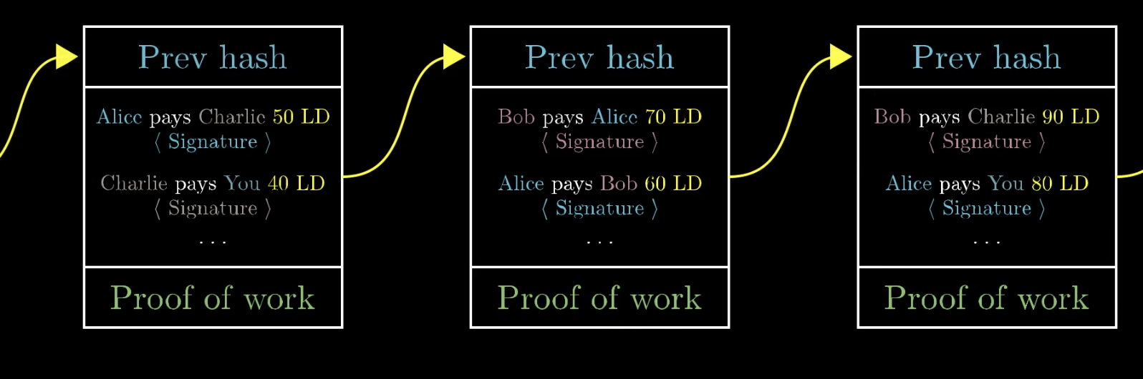
Recap: Blockchain
Replicated/duplicated database that keeps a permanent immutable record of digital transactions.
A Basic BTC blockchain:
Block = Previous Hash + Signed Transactions to be recorded + Proof of Work to generate the Hash to lock in the Block.
Blockchain = Blocks containing Transactions linked and chained together by Hash of the “previous block”
Feature <> Properties:
SHA256 <> Immutable and permanent - very hard to reverse engineer
Along with mechanics of mining = a PoW blockchain is highly secure.
LD = Ledger Dollars (Your invented token that is a unit of account in the network eg. BTC)
Notes:
Use the layman analogy of:
Apple swap for BTC. willing buyer willing seller = lock in of “one apple value” > geeks loving the cool concept > silkroad > liquidity establishment of BTC > into other alternative coins.

Slide 8

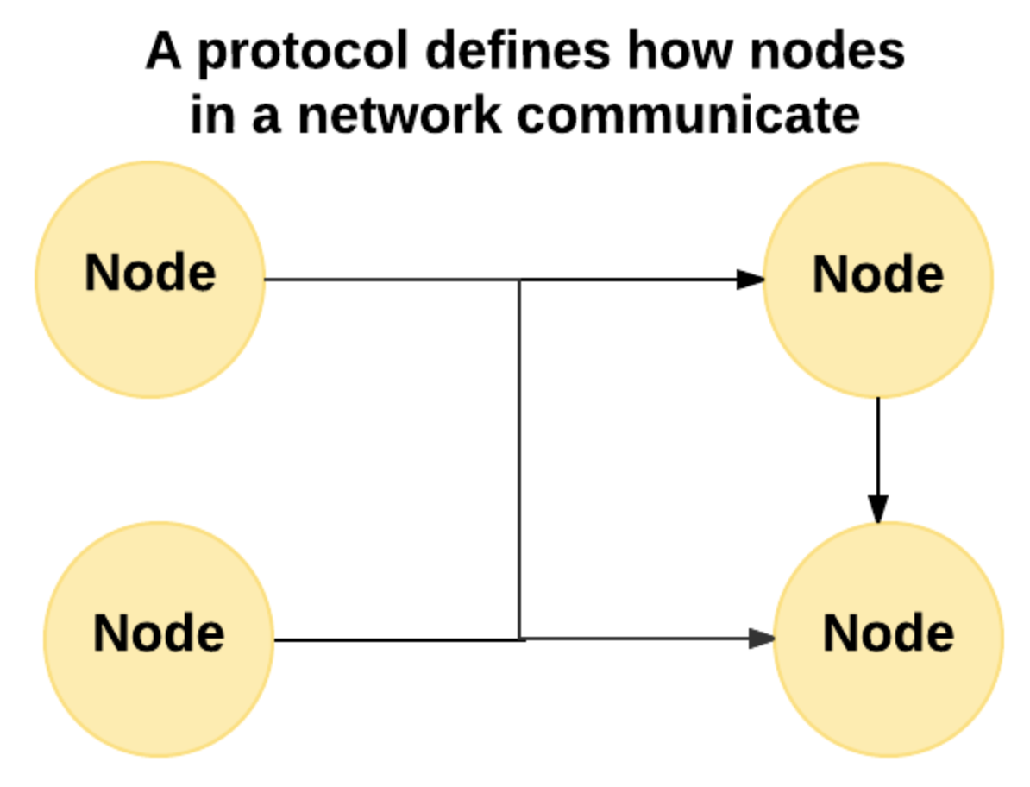
Recap: Protocol
The rules of a blockchain network defining how nodes (participants) of the network can operate
> In BTC or public chains: it usually contains economic incentives for self sustainable validation
- ie. BTC network has incentive reward in its protocol for miners for validating transaction = secure self-operating network.
> Protocol innovation:
All kinds of rules can be set, and improved upon for the network
Provide for smart contracts/tools for D-Apps to be build on top of it
Notes:
- More light into Private vs Public Blockchain

Slide 9
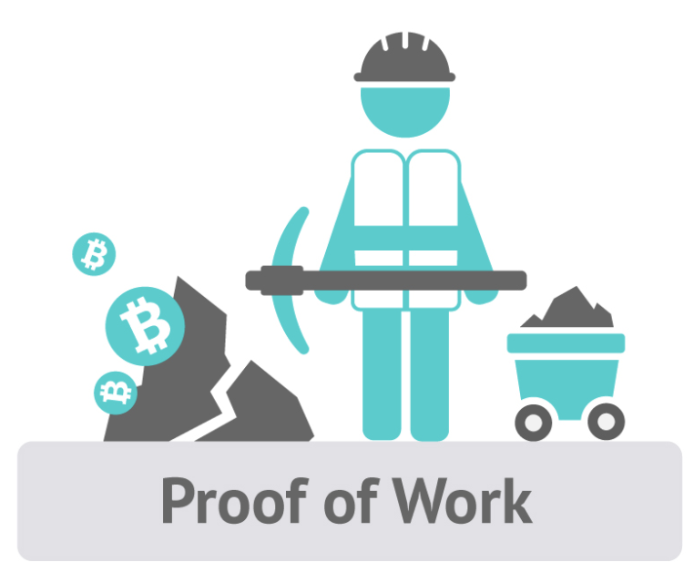
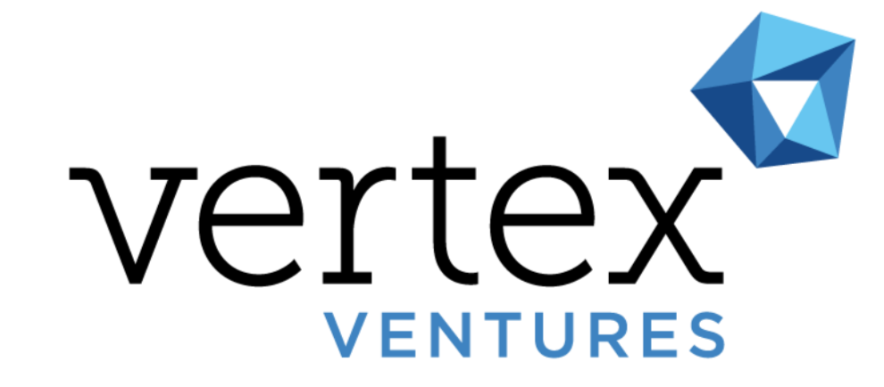
Recap: Blockchain - Miners
Miners are participants in a Blockchain network who perform valuable work required for the network to operate
BTC Mining <> Proof of Work:
Miner solves a complex puzzle to find the Hash aka “Golden Ticket” that proves that “I did valuable work”
ie. Trades Energy > Computational Resource > Hash for Block Reward (BTC)
Other forms of consensus algorithms developed over time:
Proof of Stake (PoS)
Directed Acyclic Graph (DAG) based consensus mechanisms
Notes:
Qns: Value captured in application vs protocol layer

Slide 10

Recap: Token
The digital asset (unit of account) of the Blockchain/DLT, follows Protocol and can be distributed throughout the network for value allocation
Network
vs
Token
vs
Blockchain Protocol
vs
Different Applications of Value
Country
vs
Currency
vs
Monetary Policy
vs
Goods and Services of value
Deriving from the BTC example:
Tokens represents the financial incentive miners (value adding participants) receive to trade resource of value <> validate transaction/perform something the network values
BTC <> Bitcoin blockchain
Zcash, Litecoin, Monero <> Forked Bitcoin Blockchain
Ether (native) <> Ethereum Blockchain (and other tokens)
Notes:
Decentralized application of Cryptokitties (without Token. Value generated without token) Google = "Crypto - personal ownership of digital asset integrated into their gaming platforms"

Slide 11
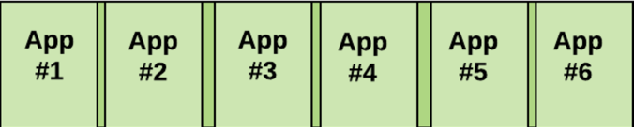
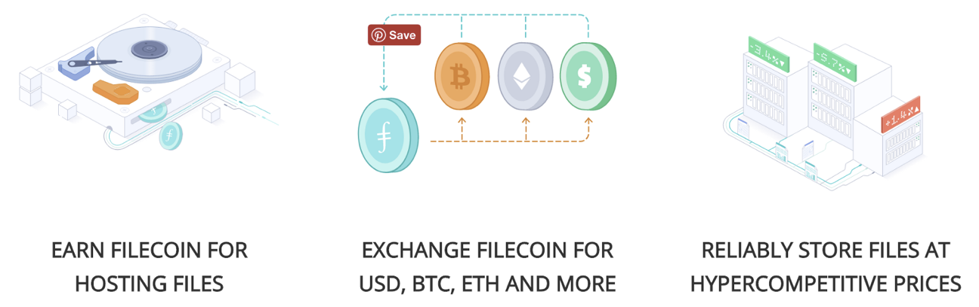
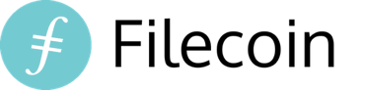
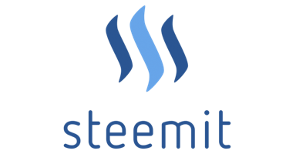
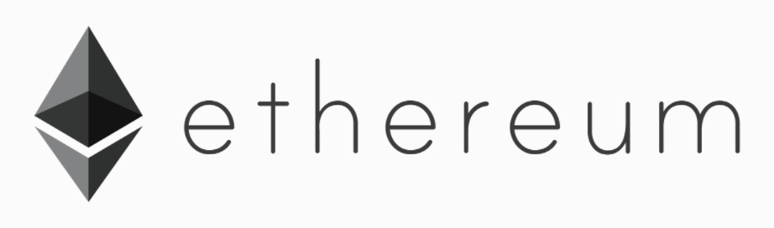
Recap: Various Applications
Can literally be any service or product
that answers the question “what the underlying technology is good for in the real world?”
-Being rewarded for writing good articles
-Smart voting and governance
-500,000 active users
-The “reddit” of crypto space now
Distributed computational resource
Runs smart contracts without relying on centralized entity
Notes:
Qns: Value captured in application vs protocol layer

Slide 12
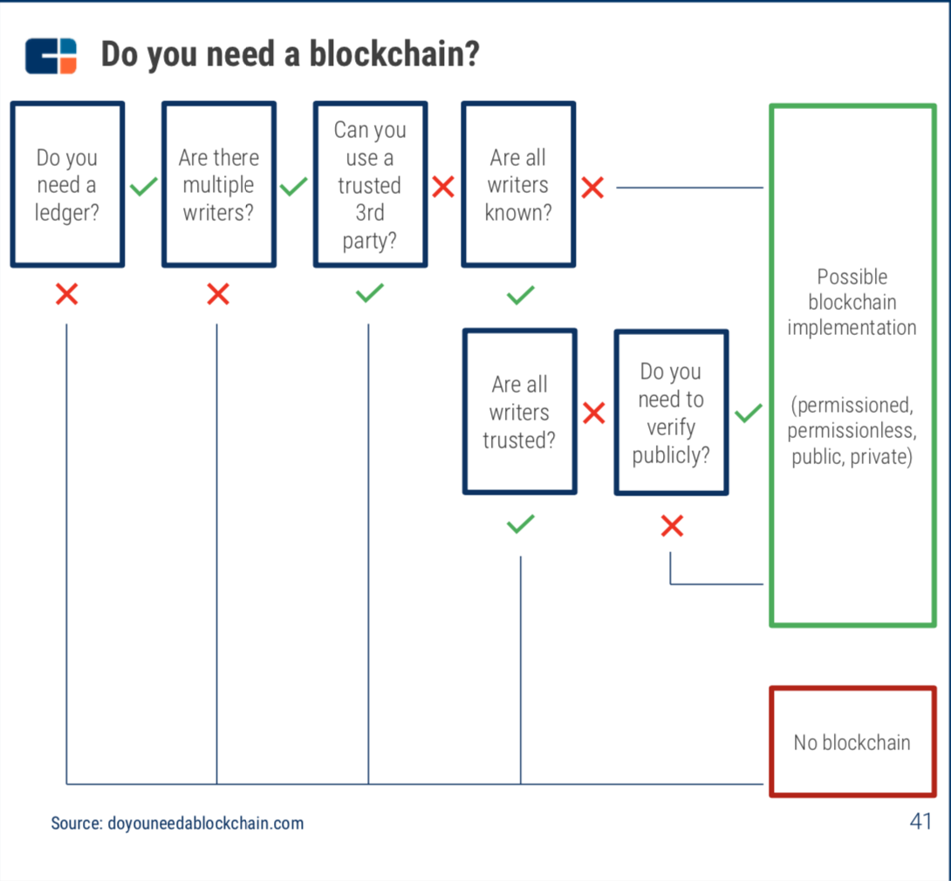
The FUNDAMENTAL Question
Notes:
Qns: Value captured in application vs protocol layer

Slide 13
Different types of DLT
VERY IMPT QNS: Type of DLT needed depends the level of decentralization required - how important is the network and how large a collusion is required to compromise it? (prevent against individuals? Companies? Associations? Countries?)
Open to Participation
Many Nodes
Public
>> Anyone can participate in the network - anyone can write/validate/read transactions (eg. Ethereum, BTC)
Hybrid
>> A mixture of privately approved participants and public participants with different levels of access to write/validate/read transactions
Private
>> Only privately approved people can participate in the network as a node - only (eg. R3 Corda, IBM Hyperledger, EEA)
Exclusive to Participation
Fewer Nodes
Notes:
Explain DLT briefly + examples. *Limit the scope abit - dont go into blockchain vs DLT*

Slide 14
Do you need a token in the Blockchain?
Answer = depends on the economic design of your the network that’s running on the blockchain (private/public/hybrid).
Ultimately, people providing something of value in the network needs to be rewarded.
Open to Participation:
Many Nodes
Assets
Public Blockchain Network
“A token is a unit of value that an organization creates to self-govern its business model, and empower its users to interact with its products, while facilitating the distribution and sharing of rewards and benefits to all of its stakeholders.”
Tokens (Required)
Decentralized Application
(eg. Ethereum computing)
Token is absolutely necessary to be able to be distribute economic value to different participants in the public blockchain network (eg. miners who validate transactions in the ethereum network gets paid in ETH)
Assets
Private Blockchain Network
Tokens (Maybe)
Decentralized Application (eg. Project UBIN on Corda)
Token might not be necessary depends on whether economic value is “sponsored” by the private organization/organizations to the network participants who “provide value” to running the private blockchain network
Exclusive to Participation:
Fewer Nodes

Slide 15
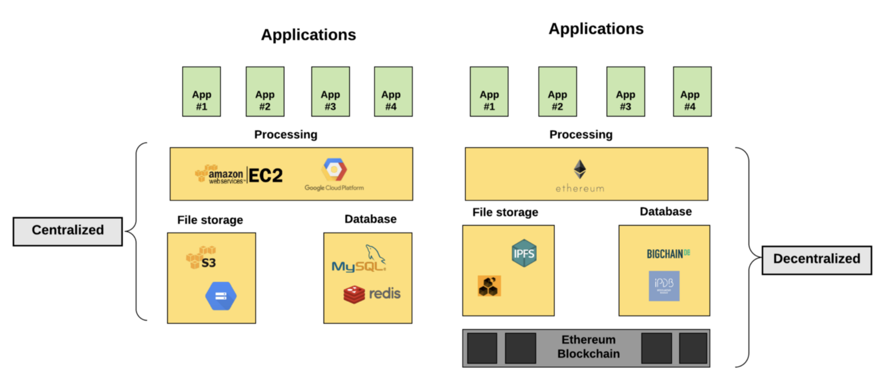
Decentralized stack vs Centralized stack
Notes:
Dapps or organizations wanting to build applications can choose different level of decentralization according to differing needs

Slide 16
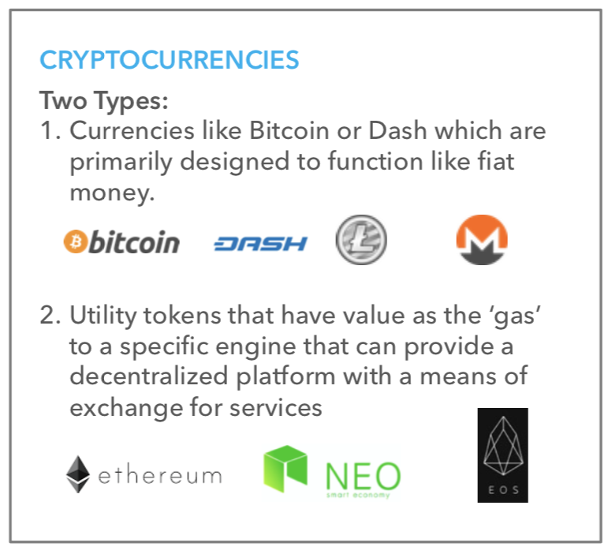
Type of Tokens
Notes:
Store of value - payment - services token
>> There’re overlaps

Slide 17

Type 1 = Utility as Currency
Basis of comparison
Fiat Currency today = Trust
Fiat currency = “Let there be”
Disjointed from the ‘gold’ standard
Derivative “trust/confidence” forms the bulk of financial instruments measured in USD value.
“All moneys that are not backed by a commodity rely exclusively on a combination of perceived value and network effect – revealed through supply and demand. Simply, the more people that agree that a piece of paper with a number on it has value, the more value it has.”
4 Facts about Bitcoin, 2017
Arguments FOR crypto-as currency | Arguments AGAINST crypto-as currency
Fiat isn’t backed by anything as well since gold standard disjoint | Super high volatility (Lack of stablecoins for day to day usage)
Electronic gadgets + Internet (prerequisite for penetration of cryptocurrencies) outpacing financial institution adoption rate by many times | Risk of governments coming together to shut down cryptocurrency entirely within a short period of time (long periods of time won’t work since capital outflow will simply cause one country to be at the economically winning end)
Infinitely divisible, immutable, secure, highly portable
Adoption of cryptocurrency beyond the point of no return - a few countries have endorsed crypto payments = hard for any country to shut it down because of fear of capital outflow due to innovation stifling
Notes:
Qns: Value captured in application vs protocol layer

Slide 18
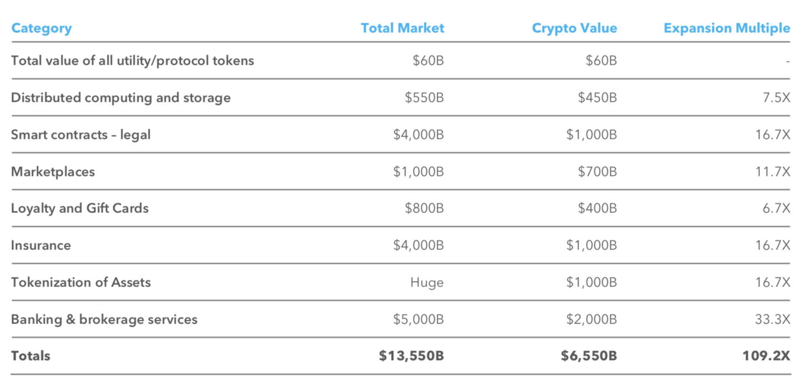
Type 2: Utility as “Pachinko” in a network providing a service/software
Token is exchanged purely for the sake of “using” a network’s services

Slide 19
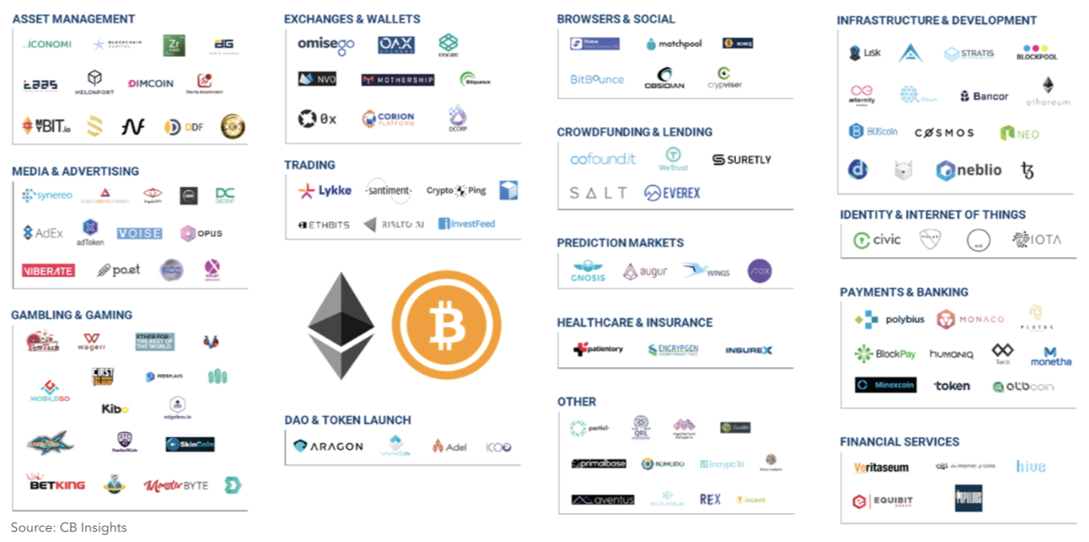
Successful ICO/ITOs
Notes:
ICOs that have raised $$
CMD: is ‘successful’ defined by how much money was raised? Or should ‘success’ be used to describe startups that actually deliver tech/services/innovation? Might be a dangerous precedent to say the entity is ‘successful’ by merely raising money.
Or put “successful” in quotes ?

Slide 20
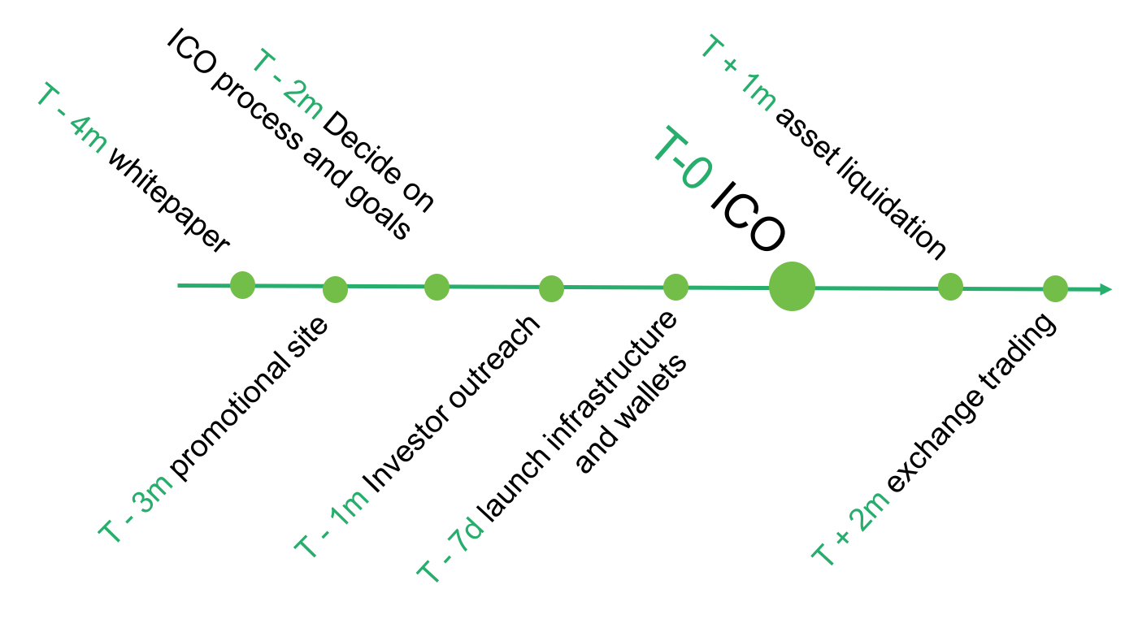
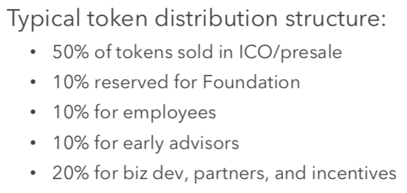
Example ICO process/structure
Notes:
Qns: Value captured in application vs protocol layer

Slide 21
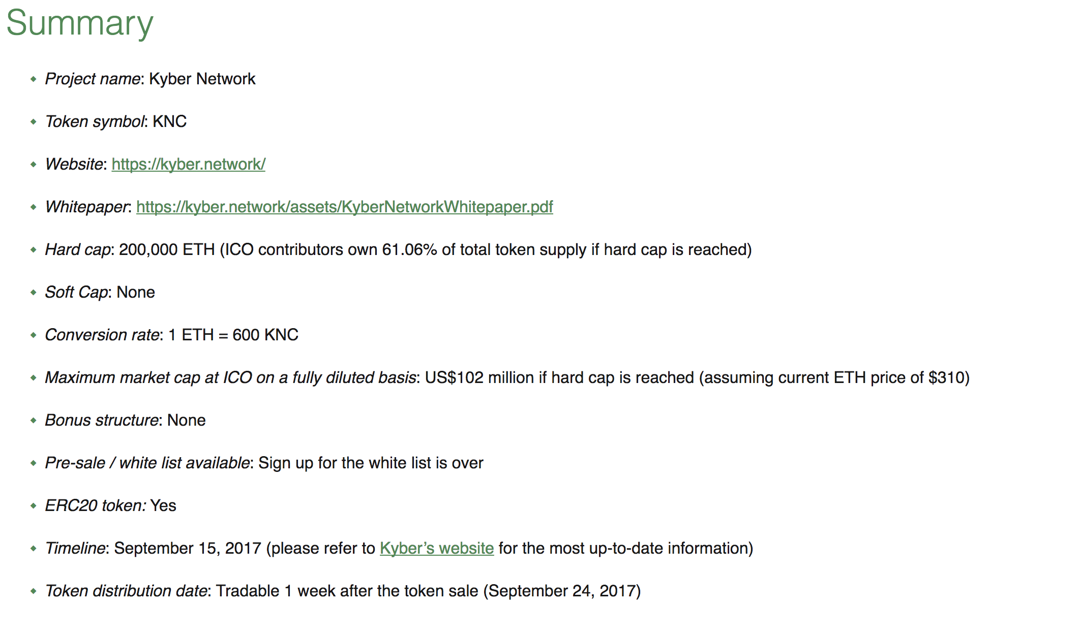
Typical ICO Information
Notes:
Qns: Value captured in application vs protocol layer

Slide 22
Typical steps to launching a “Legit” ICO
Product Planning: Decide on the decentralized thesis, business & technical angle whether or not it , be it building from scratch or from existing relevant business/prototype.
Getting Advisors: Plug your weakness by roping in advisors especially recognized face in crypto-scene.
Product/Community Marketing: Start updating your intended investor/user community of your vision and rough plan.
Developing a Whitepaper: Your business + technical plan including token structure, proceed usage, road maps.
Seeking legal council: Define legal jurisdictions you will touch and cover all possible pitfalls: AML/KYC/taxes/securities etc.
Token Sale Marketing: Time to “shill”/share your specifics of token sale structure/etc to your growing community.
Releasing code and audits: Share your smart contract code for peer auditing.
Pre-sale and Public Sales: Ideally doing a good pre-sale with crypto-strategic money will lead to a successful pubic sales due to association.
Proceed conversion: Post ICO liquidation management is very important to both manage confidence in project not being a “hit-and-run” and also to fund the project amidst volatility.
Post ICO milestone updates: Product should be out asap (best if prototype is available before ICO) and possibly an exchange listing post ICO. Updates should always be constantly delivered diligently just like an “IPO-ed” company.

Slide 23
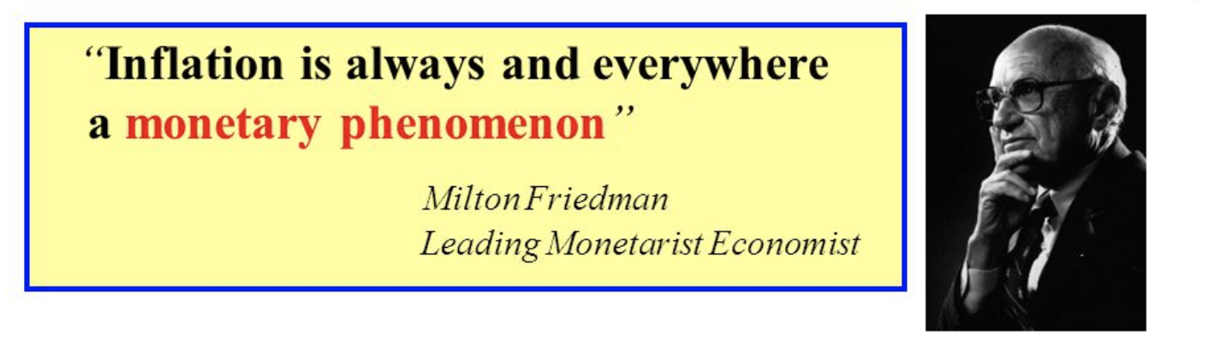

Redflags in (Public-oriented) ICOs
Rent-seeking ICOs (value extracted from the network transactions to reward token holders/3rd party = middlemanning!)
“Value” is recognized NOT as ‘revenue’, but as ‘gas’/’fees’ participants paying OTHER participants in the network for doing valued work (Think ‘miners’ validating PoW/PoS/etc protocols)
Value of network is derived mainly from [[MV=PQ]] and generated by how much/fast the network’s token/coin (M*V) is actively exchanging hands (V) for using the network, trading for the quality and perceived value of product/service (P*Q)
Raising money purely for an investment vehicle that is in itself centralized
Textbook security token definition and should be treated as a conventional security route

Slide 24
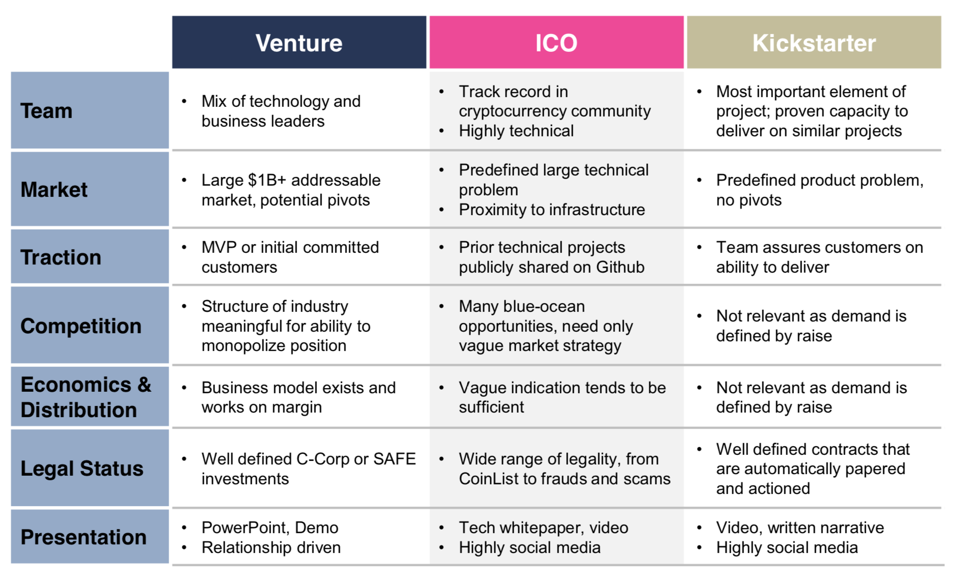
ICO vs VC vs Crowdfunding
Notes:
Qns: Value captured in application vs protocol layer

Slide 25
Summary of Challenges
Vastly different valuation framework: Ethereum @ 2,000x vs Facebook @ 14x
Easily manipulated markets (existing centralized power prevents actual decentralization)
“Mining” is NOT decentralized. $ = Energy = Control of mining power
Heavily biased press: Coindesk owned by DCG
Misuse of ICO funds and the prevalence of scams
Technology infancy - On-chain transactions are expensive and high energy guzzlers >> Technical improvements (ie. Lightning/Plasma/Zilliqa)
Cryptocurrencies are a KYC/AML/CFT disaster, lots of friction between fiat-crypto movement.
From the utility-currency angle - there is immense volatility.
Notes:
@Ming You: recent scandal “painting the tape” =

Slide 26
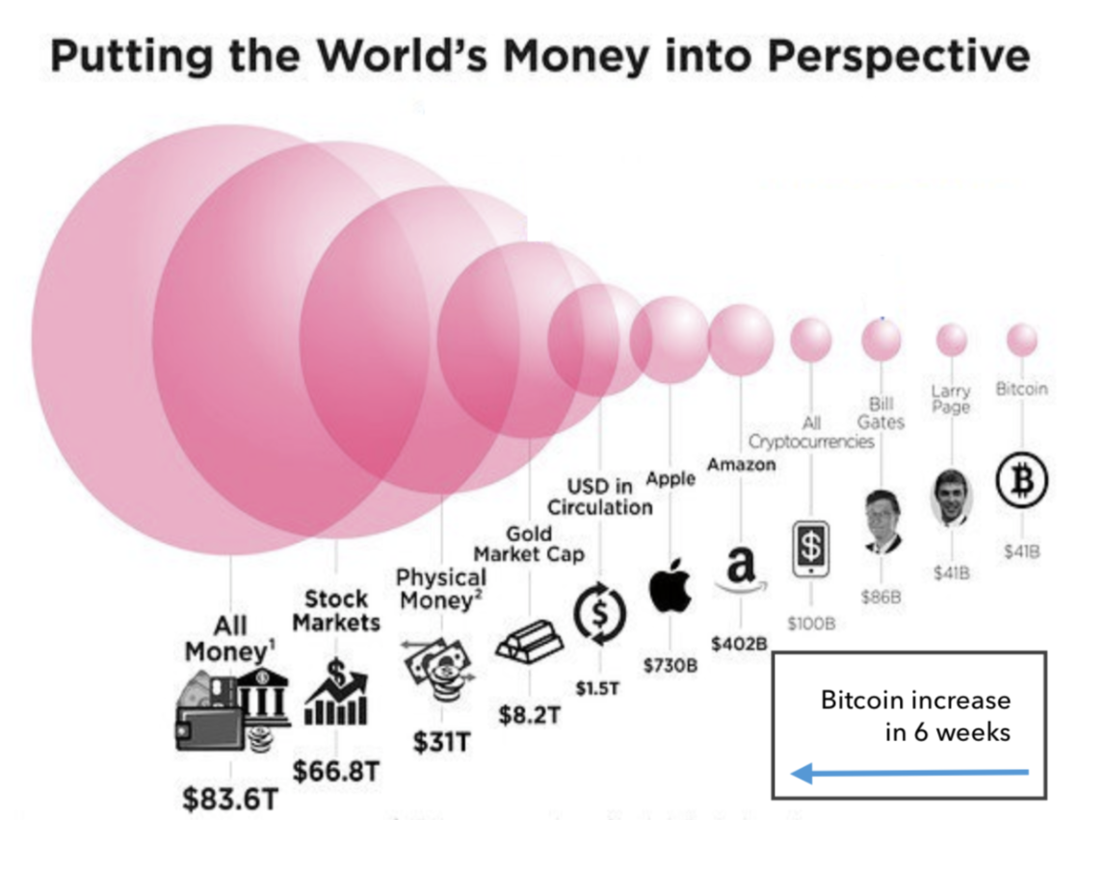
Challenge: Vastly different valuation framework
High expectations to live up to according to P/E prediction model (FB = 14.4x vs Eth = 2,000x) which is beyond most current mental models of traditional investors into companies.
>> Possible Valuation framework within a functioning utility network
Assuming mass adoption in the long run
Valuation of public tokens: MV = PQ (Concept of GDP as compared to revenue
Notes:
Qns: Value captured in application vs protocol layer
Unsustainable Revenue Multiple (Expectation

Slide 27
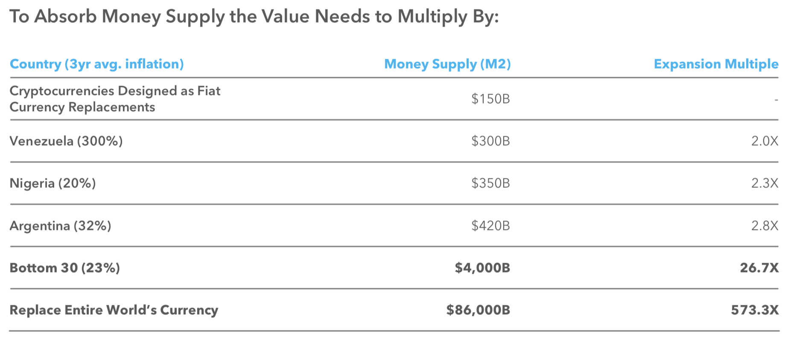
Challenge: Valuation framework - ct’d..
Valuation framework - fiat currency replacement?

Slide 28
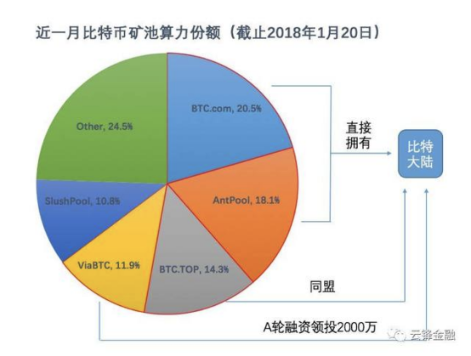
Challenge: Easily Manipulated Markets
Mining is NOT decentralized. $ = Energy = Control of mining power
Majority of the mining power controlled by huge miners (4 companies controls >50% = 51% attack?)
Heavily biased press: Coindesk owned by DCG
Remedies: More diverse pool of blockchains that disjoints from a single form of “network value add” such as PoW and energy/mining centralization = Proof of Stake, Proof of Loyalty etc.

Slide 29
Challenge: Misuse of Funds/Scams
All funds from seed/A/B/C are raised up front.
Lack of impetus/discipline to continuously achieve (no need to reach milestone to raise another round of funding)
Market iteration is limited, too much focus on R&D as compared to actual market deployment (ie. key developer hire (mooooon), partnerships (moooon), etc)
Remedies = DAICOs / Augmented Vesting
Funding “Tap” mechanism in the smart contract holding raised funds
Moderated release + built-in clawback
Notes:
https://cryptoslate.com/understanding-daicos/

Slide 30
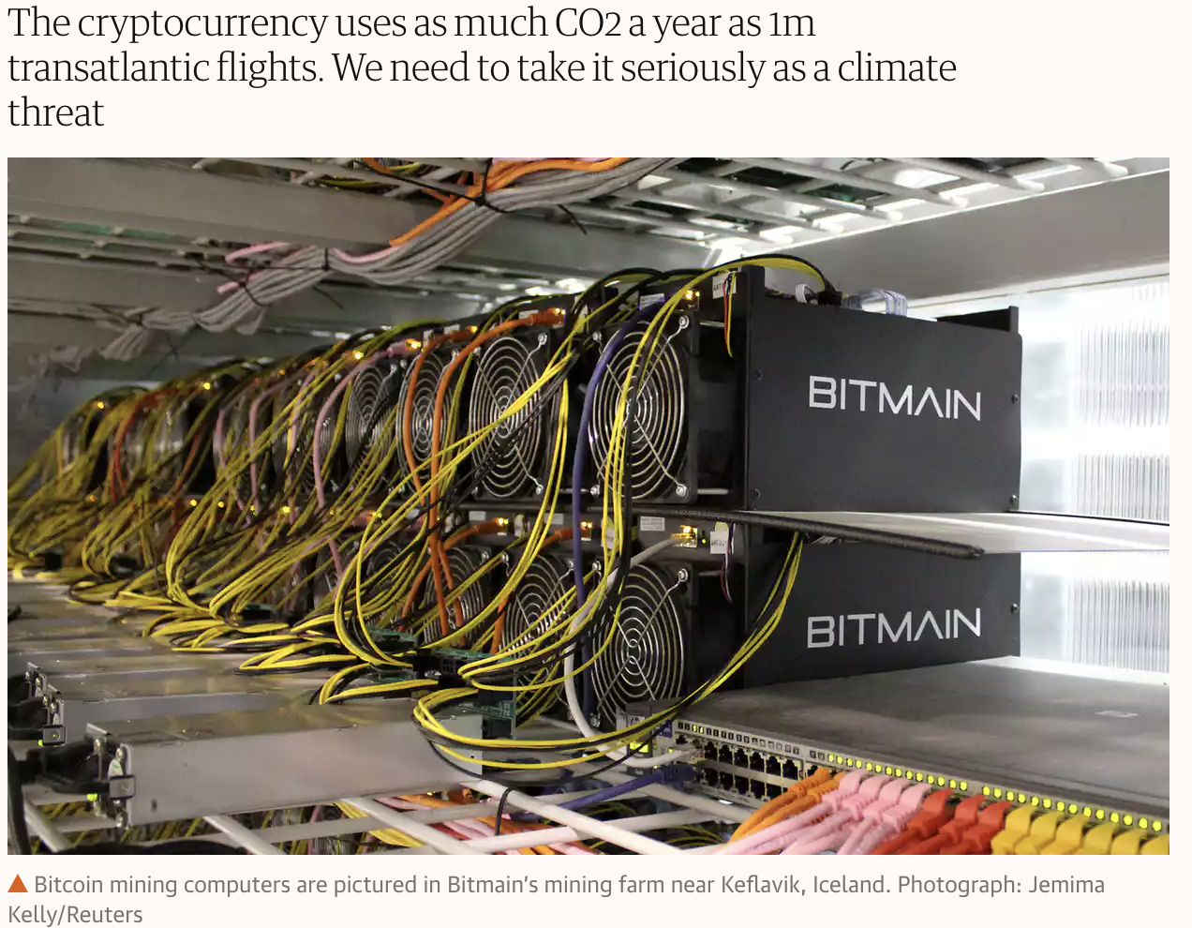
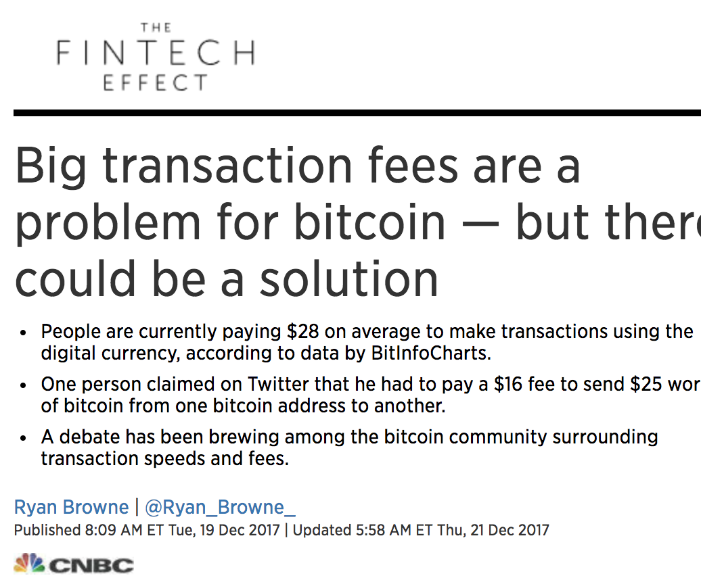
Challenge: Technology Infancy
Decentralized On-chain transactions demands high energy via Proof of Work protocols and is getting very expensive.
Remedies = Technical Improvements:
Lightning implementation (BTC)
Plasma implementation (ETH)
New type of blockchains with various approaches to reach consensus (eg. PoW, PoS, DAG)
Notes:
DLT framework = https://twitter.com/VladZamfir/status/942274730182283264

Slide 31
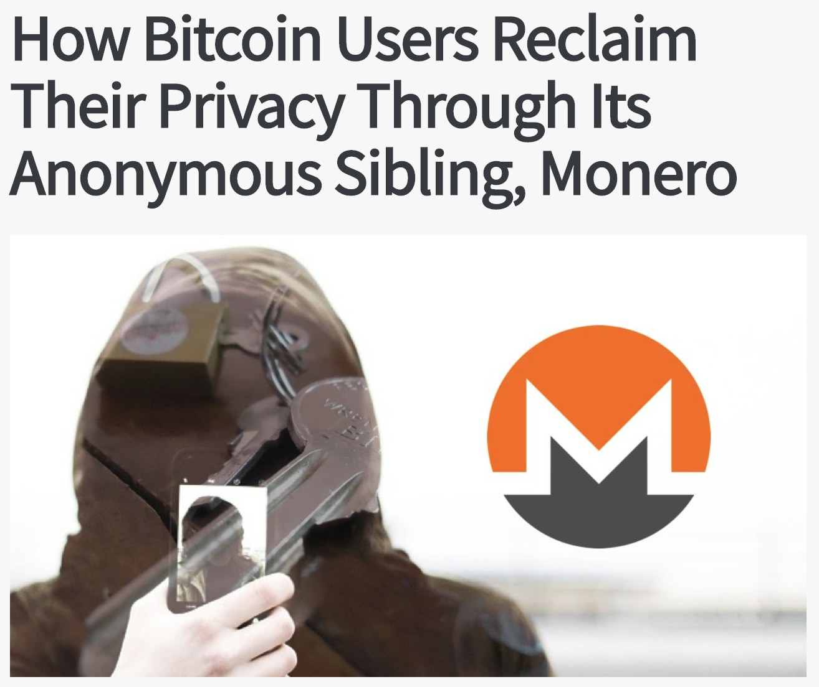
Challenge: KYC/AML/CFT disaster
Traditional financial institutions face traceability/responsibility issues with cryptocurrency usage
Anonymity is a huge pain for BTC and alternative currencies. Privacy-focused coins such as Monero makes it worse.
Global reach compounds the problem due to jurisdiction blurring by various participants in a crypto-transaction.
Remedies = AML/CFT tracing software performs various cryptographic triangulation on the respective laundering blockchains + offline PI, increasing the ability of traditional financial institutions to legally participate in large quantum fiat-crypto transactions and flag out potential CFT risks to governments.
Notes:
http://www.fatf-gafi.org/media/fatf/documents/reports/Virtual-currency-key-definitions-and-potential-aml-cft-risks.pdf

Slide 32

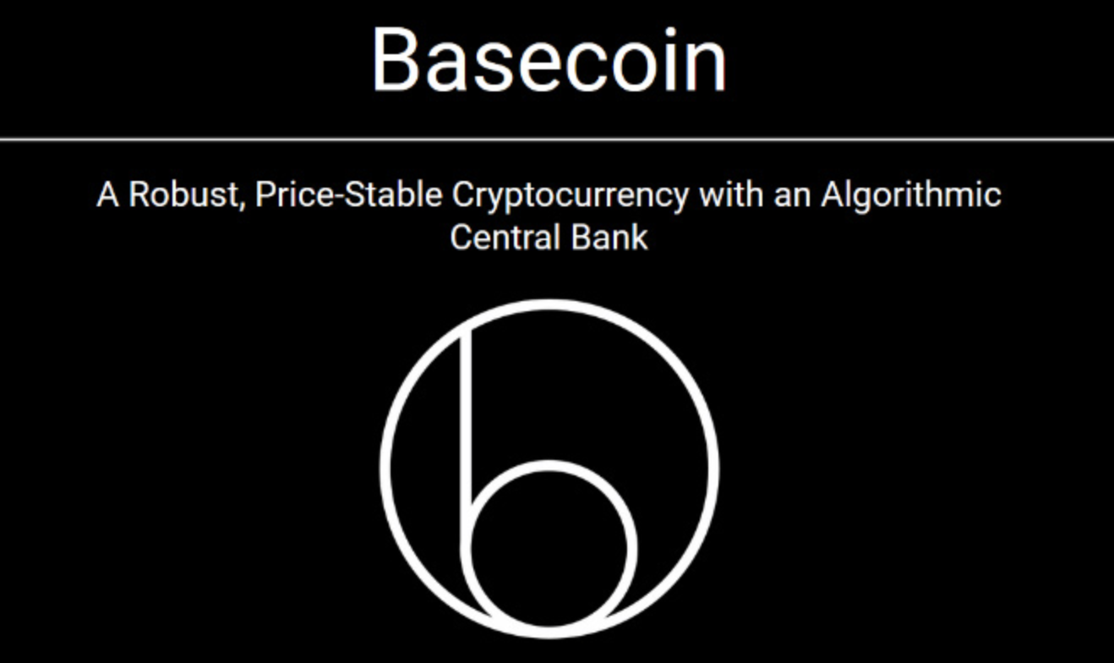
Challenge: Immense volatility (Currency)
Most Dapps rely on ETH or an ETH pegged internal token to distribute economic value in the network that it runs.
Volatility is heavy and causes chaos, preventing people from actually using ETH/tokens to “consume real value” like a real currency.
Remedies = Invention of stablecoin such as Basecoin and MakerDAO - using algorithmic basket-ing of *usually* one or more conventional asset class to interface with the crypto-world + smartly engineering the own coin supply as markets shifts.

Slide 33
ICO Legality
Gilbraltar
Australia
European Union
Hong Kong
Canada
United States
Japan
Switzerland
Friendly
Unfriendly
Estonia
Germany
Israel
Singapore
Russia
South-Korea
China
UK
Thailand
Philippines
Note on Security vs Utility Token:
Security token’s definition worldwide is mainly set by the tone of United State’s SEC, most countries where ICOs are allowed only clamp down on non-compliant security tokens.
Security tokens requires proper regulations as security per SEC regulations.
Utility tokens that are meant to be used within a decentralized network (pachinko coins) are rare.
Notes:
https://www.bitcoinmarketjournal.com/ico-regulations/

Slide 34
ICO Legality - Recommendation for SG
Clear regulations needs to be ascertained to support innovation capital inflow for Singapore’s strategic interest moving forward.
Key = Singapore’s unique nimble regulatory position amidst larger and less nimble fragmented state/country systems (US/China etc) is favorable to establishing a mid-term competitive advantage to create a thought-leadership position in our financial position worldwide.
Prompt engagement in the form of round-table among reputable ICOs(DO NOT judge by amount raised)/law firms/established funds/industry partners to assemble different lens.
KYC/AML/CFT discussions should be brought up post clear definition of crypto definition to address crypto-fiat risks.
Firm up Security token definition
Define “smells” like a security.
Capital gains? Regulate ICOs to disclose process to establish soliciting token sales with intent of promising capital gains?
Define new sub-category of security tokens under existing securities treatment
Highly revolutionary in creation of a new sub-asset class with exemption/additional clauses for regulations for consumer protection → Allow for participants in crypto ecosystems to have “safe and clear” appreciation frameworks
Firm up Utility token definition
Define tokens into “fungible currency” tokens vs “limited-utility” tokens.
Define clear tangible boundaries between the “capital appreciation” angle of utility tokens and relevant treatment

Slide 35
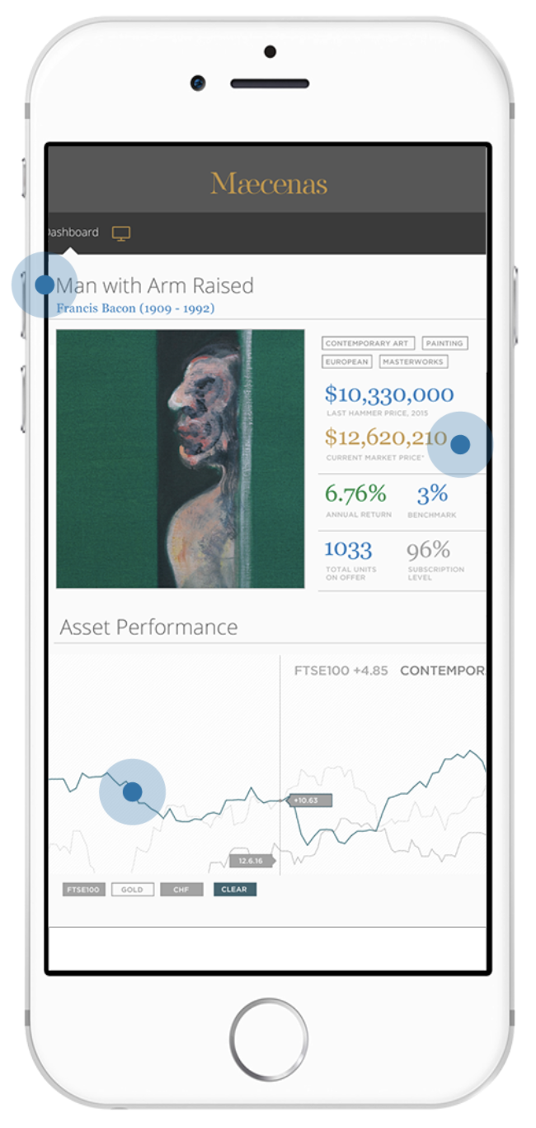
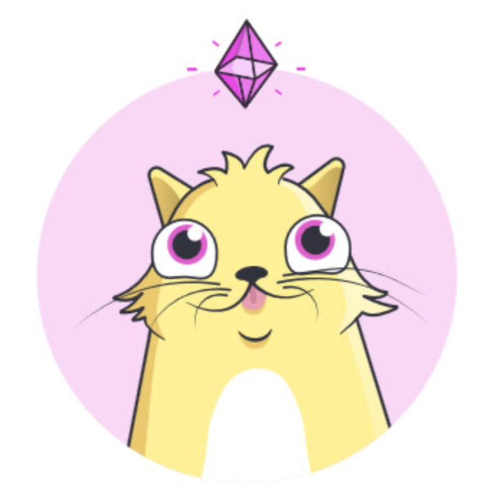
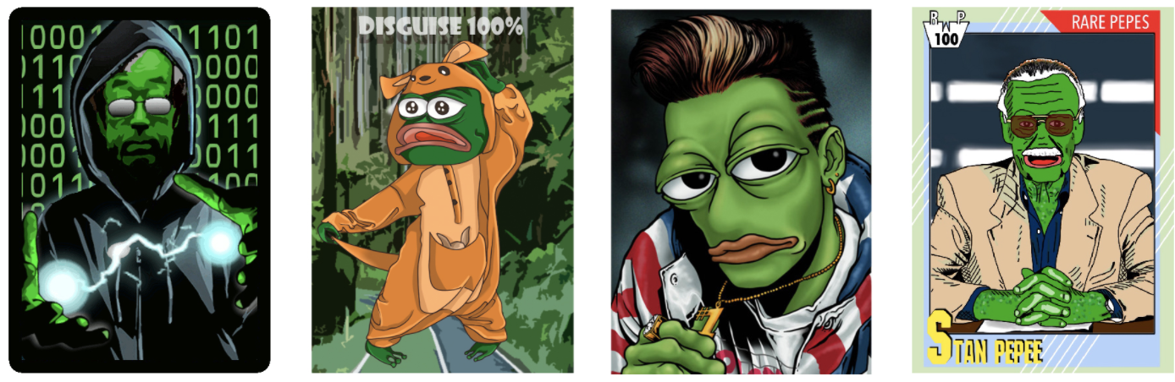
Case Study - Beyond tokens: Cryp-llectibles
Collectibles, art pieces and essentially stuff of value benefits directly from blockchain implementation.
Cryptokitties. “Genesis” unique kitties easily fetch 6 digit figures.
Rare Pepe. “Lord Kek” last spot price was at 22k USD.
Maecenas. Democratizing ownership in Warhol, Monet, Picasso
Benefits:
Offers traceability of value of art piece
Anti-forgery/duplicates
Ownership protection against theft
Preservation of value in generation for things of scarcity and of value.
Notes:
https://motherboard.vice.com/en_us/article/ev57p4/i-went-to-the-first-live-auction-for-rare-pepes-on-the-blockchain
https://hackernoon.com/the-effect-of-cryptokitties-97a9daaab2ad
https://medium.com/@coin_and_peace/rarepepe-is-the-most-innovative-project-in-the-crypto-space-seriously-6d6b74749687

Slide 36



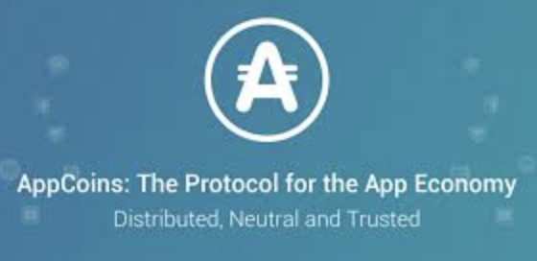

Case Study - Traditional to ICO
Independently can survive as a startup and grow as traditional startup company:
Binance/BNB = Exchange to cater to demand in trading cryptocurrency
Omise/OMG = payment gateway/point-of-sales startup in developing countries
Uplive/GIFTO = Live-streaming
Aptoide/APPC = One of the largest Appstore in the world
Telegram/TON = Encrypted messaging app raising 1.2B USD++
>>All of them have been good businesses WITHOUT going through ICO.
Question: How do you ultimately benefit from ICO path - even if crypto tanks = what are the assets accumulated post crypto boom?
Benefits | Drawbacks
Issues tokens without diluting existing stakeholders - faster return of liquidity to earlier equity investors (next to immediate) | PR/Regulatory risk - startups in certain sectors might be deemed “too wild” to work with for strategic traditional partners. Eg. Banking/Government/etc
Allows economic value creation (both utility and secondary markets from get go) | Retail token ownership = much more noise in shaping roadmap of people. Masses aren’t known for making great long term decisions. Management needs to be super focused and disciplined (pressure to ‘Moon’ and ‘Lambo’)
Cash is king = hiring power, marketing power, B2B bargaining power | Liquidity risk is always there since it’s not advisable to “liquidate” both team tokens and raised ETH/BTC to fiat immediately, subject to crypto’s volatility.
Free PR all year round if managed well as long as cryptocurrency market exists + Free users because token holders automatically have incentive to use your product
Notes:
More Examples throughout presentation

Slide 37
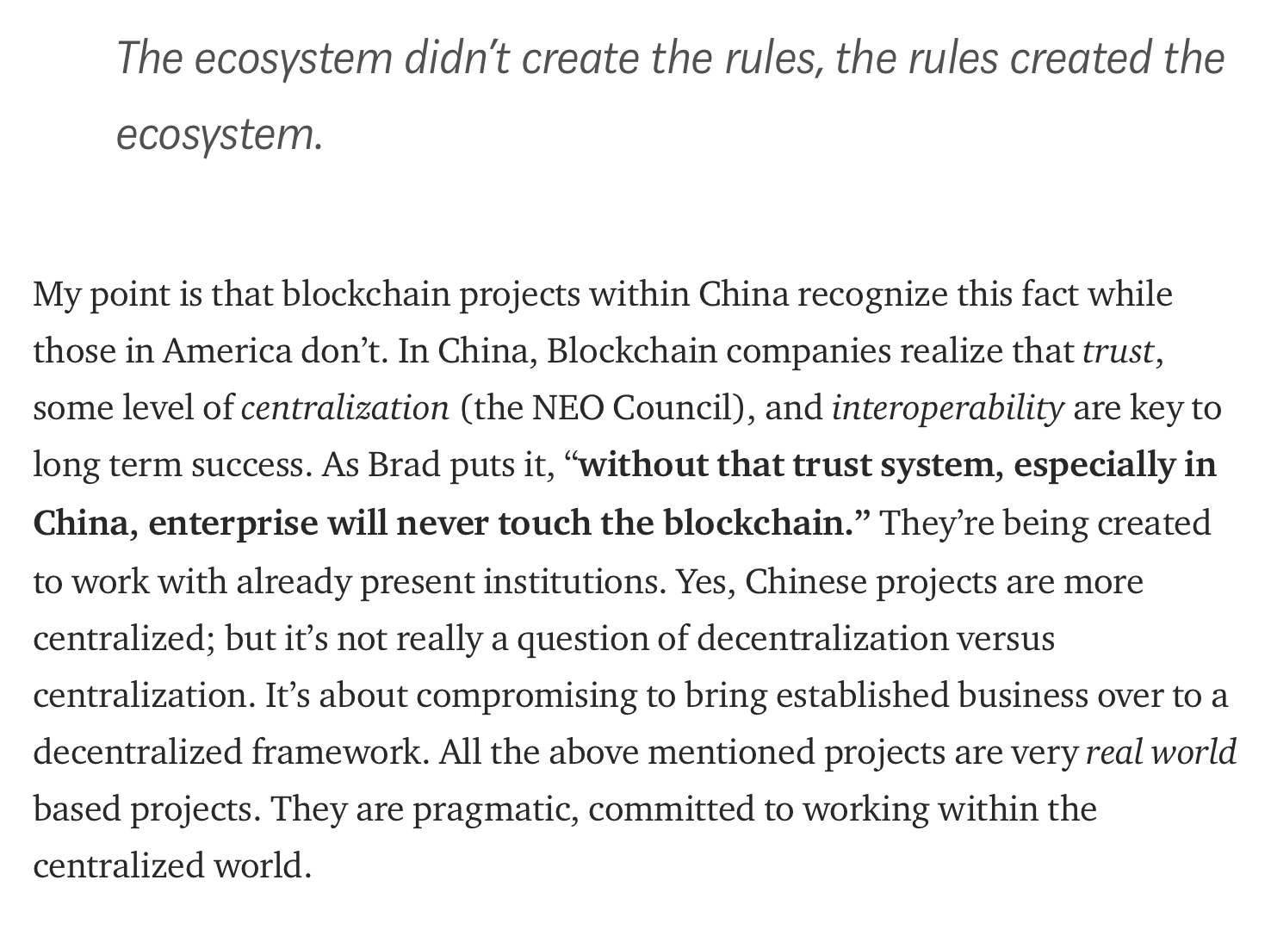
Industry Note - China’s Blockchain Scene
Let’s face it - the second largest (eventually to be first) economy in the world not in blockchain/crypto is a bummer
Blockchain has been heavily promoted with CCP’s stamp of approval (appearance in 人民日报）
Private/Hybrid permissioned tokens are all the rage - Vechain for example has government endorsement for deployments around KYC/Supply Chain for blockchain projects on a MNC and even city level.
Cryptocurrency and new ICOs itself is banned entirely subject to future regulation changes in the government.
Ban on cryptocurrency exchanges will be the first to be lifted and regulated as state-approved exchanges
Noam Levenson, CEO of Eden Block
Notes:
https://hackernoon.com/an-undervalued-blockchain-market-in-china-is-good-news-for-you-d0c010170622
China visit - the facade from outside that china is against crypto and blockchain is false.

Slide 38
Overall tips on Project Selection
Way too much fluff exists in crypto scene, some metrics to filter projects by a few points:
Decentralization:
Decentralization and centralization have their pros and cons by technical design and is not going away anytime soon (most remedies are varying degree between the decentralization scale) Skip teams who blindly believe in either with no logical breakdown to relate back to the technical capabilities of the blockchain infrastructure.
Governance:
Teams that are crystal clear about where in the growth curve they are would be best. Rule of thumb: autocracy works better for acceleration phase, democracy works better for stabilizing and preventing deceleration.
Target Market:
Only deal with teams that know that they do not know. Decentralization is not a business model change, it is happening on a much wider scale and longer time horizon where nobody knows how big/small the market can get.
Marketing:
Core blockchain revolution is not on a 1-2 years time horizon. Generally avoid high marketing focused teams: less above average returns because all investors get in (including retail), high chance of overpromise and underdelivering + time wrong spent.
Teams: Almost the same as traditional VC investment. Note to take is avoid self-proclaimed “serial entrepreneur” = big ego = big failure rate in uncertain long time horizon vertical.
Competition:
Ignore this generally, build for the long term competitive scene not the short term. Short term problems in crypto are generally fixed extremely fast by existing organizations due to the premium involved. Teams with focus around teams are better IP than IP in the crypto scene.
Notes:
More Examples throughout presentation

Slide 39
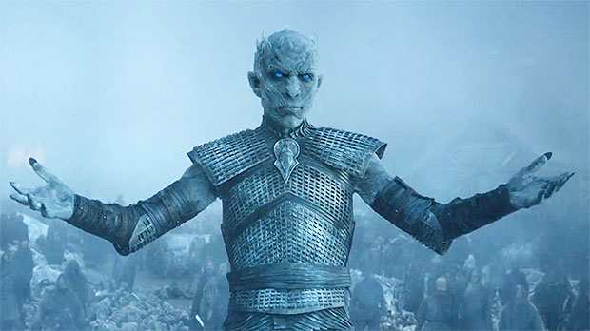

Crystal-ball Gazing - Macro state of Westeros
Context - A Game of Thrones Analogy:
Winter is coming = Fear-Uncertainty-Doubt (FUD) in the market amidst fake news, misrepresentations, 99% of GRQ scams etc
Private Chains: Lannisters - Right wingers =
Large private groups power-hodlers obsessed with secrecy and hanging on to control, sees people as milkable assets for own benefits. Operating from a deeply rooted scarcity mentality due to capitalistic teachings.
Hybrid Chains: Tagaryens - Mixed wingers =
Adopts a mixture of people oriented social benefits while still maintaining a certain degree of secrecy, noble aristocratic beliefs and capitalism structures.
Public Chains: Jon Snow & Wildlings - Left wingers =
Everything is for returning power to the people but generally messy and chaotic, fails at efficiency during times of great chaos and change due to the lack of willing leaders to want to be “King of the North”
Notes:
More Examples throughout presentation

Slide 40

Crystal-ball Gazing - Macro state of Westeros
Possible Scenarios (% probability)
1 (60%) = New world order. White walkers get driven back. Cooperation between all 3 westeros parties
2 (10%) = New world order: White walkers own the world for a short term as with all FUDs. Implosion of 3 parties in the short run.
3 (30%) = New world order. 1 Westeros faction defeats everyone else: Danny gives birth to more dragons and the horse people and kills everyone (59%) Or Jon Snow gives birth to dragons + the northern wildlings + everyone else as allies (39%) OR Lannisters somehow manage to invent the Death-star to kill everyone (2%)
The world is changing regardless and it has a high probability of landing in hybrid chains era.
Pure centralized ownership is beginning to fail the interconnected world and people are demanding drastic shifts from status quo. How fast, how slow?
That only affects future value and discounted pricing of any “crypto” project but it is next to certainty (2% probability) that things will go back to the pure centralized world model.
The saga is scheduled to unravel in 2019 :)
Stay tuned.
Notes:
More Examples throughout presentation

Slide 41
Our potential stance - A House View
MV = PQ as basic understanding.
Equity deals with BaaS (non-token)
Timely relevant verticals = supply chain, provenance,
Questions 1 and 2 answered.
Token deals (KIV pending SG clear definitive regulatory stance) potential John Pfeffer valuation benchmarking model:
Protocol and more basic plays era
Application layer needs to be where existing systems are *really* not able to solve.
Q1 - 3 answered with comfort level in the following:
(John Pfeffer style)
Notes:
More Examples throughout presentation

